Slide 1
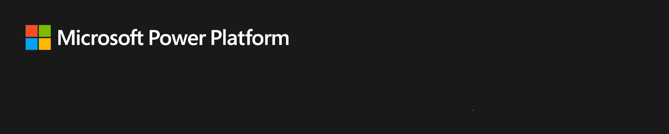
Power Platform Custom Connectors Zero to Hero
April Dunnam Partner Technical Architect, Microsoft
Connect With Me @aprildunnam | www.youtube.com/c/aprildunnam | www.linkedin.com/in/april-dunnam

Slide 2
Agenda
Understand what connectors are
Why you would want to use them
How to create a custom connector
How to use that connector in your Power Apps and Flows

Slide 3
What is a Connector?
A wrapper around an API
How the Power Platform communicates with services

Slide 4
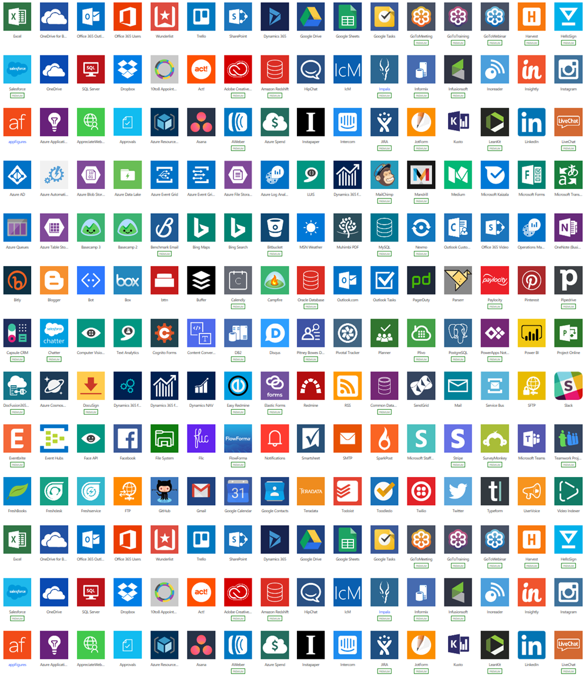
Enabling digital transformation across the organization
325+ connectors

Slide 5
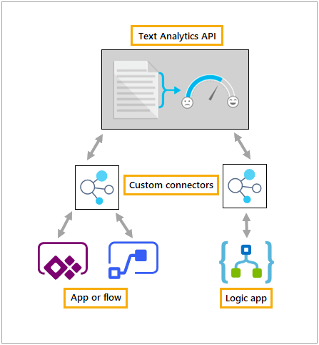
Why Use Custom Connectors?
One of the easiest and most impactful ways you can extend the Power Platform
Bring data from public and private API’s into the Power Platform
Extend/Consolidate some of the prebuilt connectors

Slide 6
Why wouldn’t I just make an HTTP request?
Simplicity
Make it easier for users to call your service
Reusability
Build it once and use it in multiple Power Apps and Flows
Avoid unnecessary overhead
Can’t make direct HTTP calls in Power Apps so you must use Power Automate
Better logging/analytics
Can monitor the connectors usage in Power Platform Admin Center

Slide 7
What API’s can I create a connector to?
Any Restful API!
Public API’s from services like Spotify, Yelp, Nasa API, etc
Public API’s you manage
Azure Functions
Azure Web Apps
Azure API Apps
And more
Private API’s via the On-Prem Data Gateway

Slide 8
Securing your API
Custom Connectors Support these standard authentication methods:
Generic OAuth 2.0
OAuth 2.0 for services like (Azure AD, Github, SalesForce, Dropbox)
Basic Auth
API Key

Slide 9
Describe the API
OpenAPI 2.0 (aka Swagger) File
Postman Collection
Start from scratch in the custom connector portal

Slide 10
Components of a Connector
Info
Name, Logo, Description
Actions
Endpoints and their visibility, headers, definitions, etc
Triggers
Timed or event-driven webhook actions
References
Resuable input and output objects
Policies
Templates for modifying runtime behavior

Slide 11

Do The Thing!
Get
Get a Power Apps Community Plan
https://powerapps.microsoft.com/en-us/communityplan/
Find
Find an API
Build
Build a Connector
Use
Use it in Power Apps and Power Automate
Share
Share how it went and what you built with @aprildunnam on Twitter

Slide 12


Join me at http://aka.ms/powerfuldevto for a LIVE Ask Me Anything on Dev.To!

